Slide 1
Quantech Challenge 2023
Spin qubit in 2D
project kickstart meeting
Mentors: Jiang Cao, Ilan Bouquet, Mauro Dossena, Qian Ding
Nano-TCAD group, IIS

Slide 2
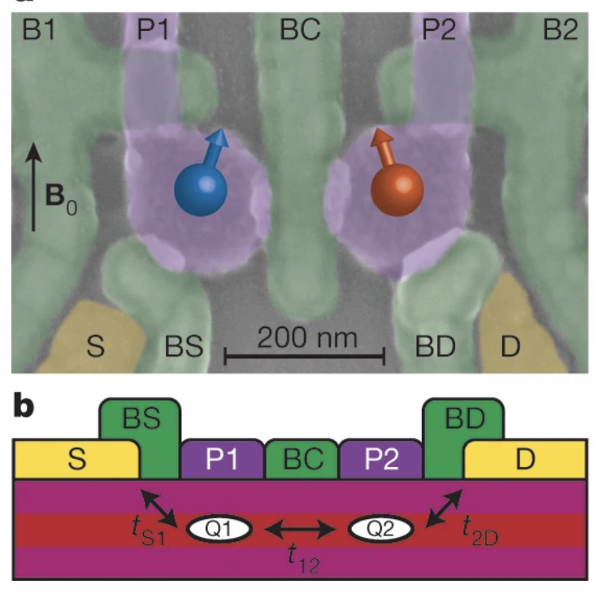
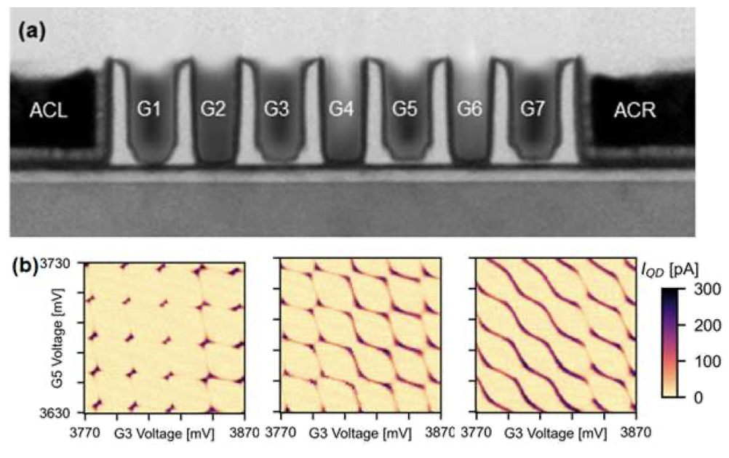
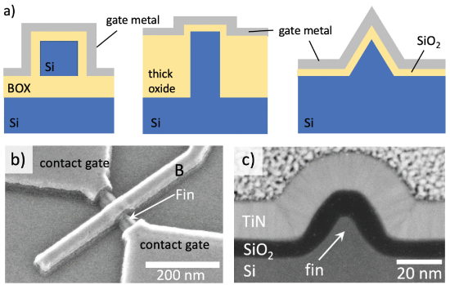
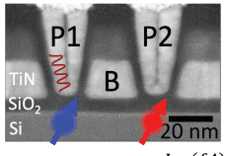
Current state-of-art quantum-dot spin qubit
😄 compatible to Silicon CMOS technology
😄 Long spin coherence time
😞 Scaling challenge
😞 Interface defect density
Do your literature study and add things
2020
2021
2022
Two-qubit gate
FinFET devices
IBM and Univ of Basel, Switzerland
IEDM 2022
Single-gate qubit operation
Si MOS and Si/SiGe QW
Intel, TU Delft
IEDM 2021
Two-qubit logic
Hole in Ge
TU Delft
Nature 2020, 577, 487-491

Slide 3
Quantech Challenge:
Main Objective: theoretical studies of experimentally realizable quantum dot spin qubit in 2D heterostructures
(1) Conventional planar SiGe/Ge structure; (2) 2D material BLG/WSe₂ structure
Main Challenges:
(1) include SOC and magnetic field into Hamiltonian; (2) QD energy-levels (3) extract g-factor and other figure-of-merits
Methodologies: two methods
(1) DFT commensurate supercell calculation → k.p Hamiltonian → QD (add B&E field, strain)
(2) DFT QD simulation (Cp2k no SOC) → TB Hamiltonian → add SOC and Peierls substitution to include B field
Outputs & impact:
write your ideas

Slide 4
Quantech Challenge: make your planning
18th Sept: starting of project
Oct: mid some results for the Ge/SiGe qubit
Nov: start BLG qubit
Dec: results for BLG qubit
Before Christmas: finish the majority of works

Slide 5
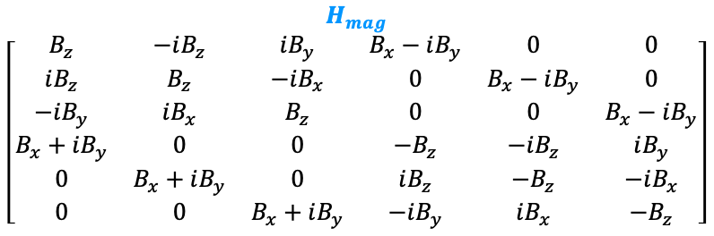
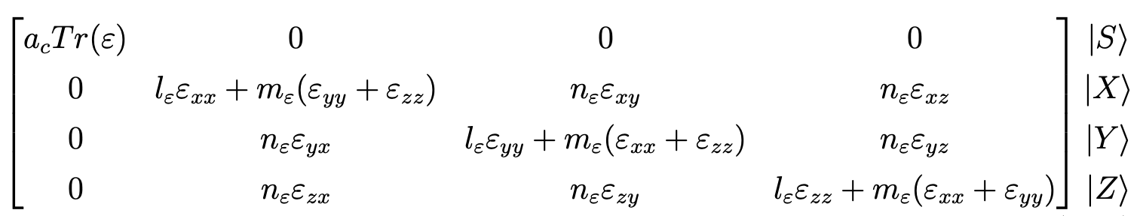
Simulation tool: QTSolver
•Effective mass-based and 6x6 / 4x4 k∙p Schrödinger-Poisson solver
•Discretization of the simulation domain with finite differences
•Simulation from room down to ultra-low temperatures (T=1.5 K)
•New additions (in k∙p model) :
Magnetic field ✓
H_{mag}
H_{strain}

Slide 6



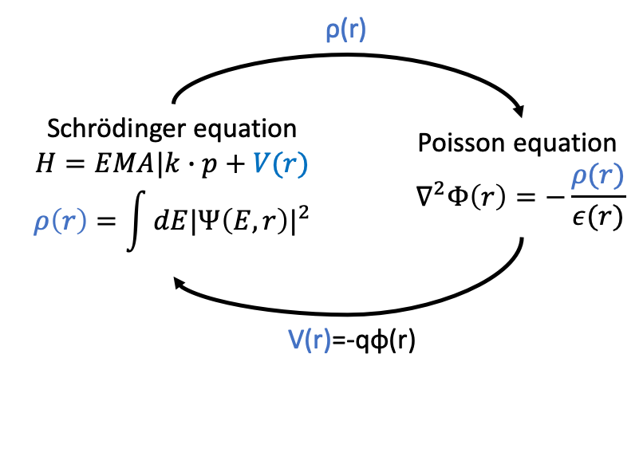
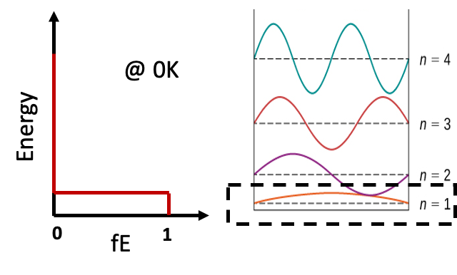
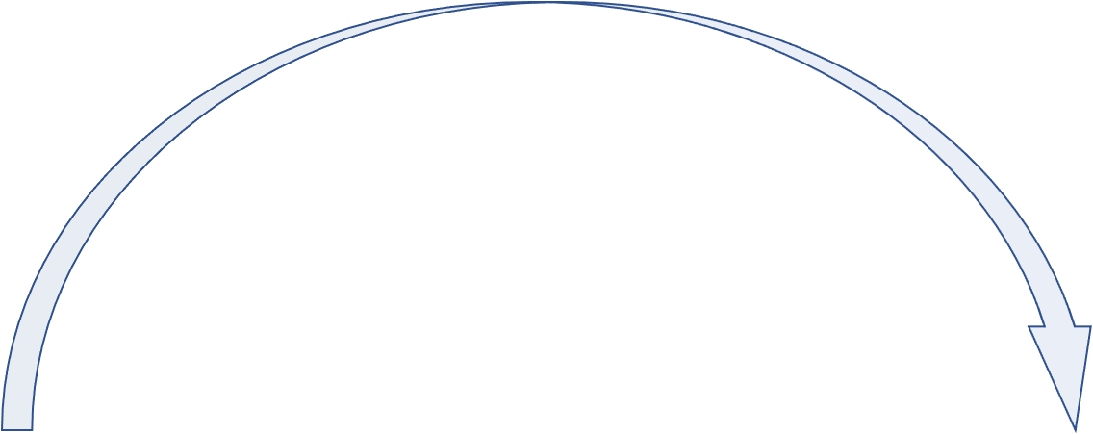
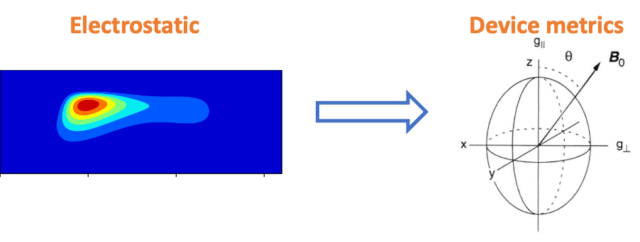
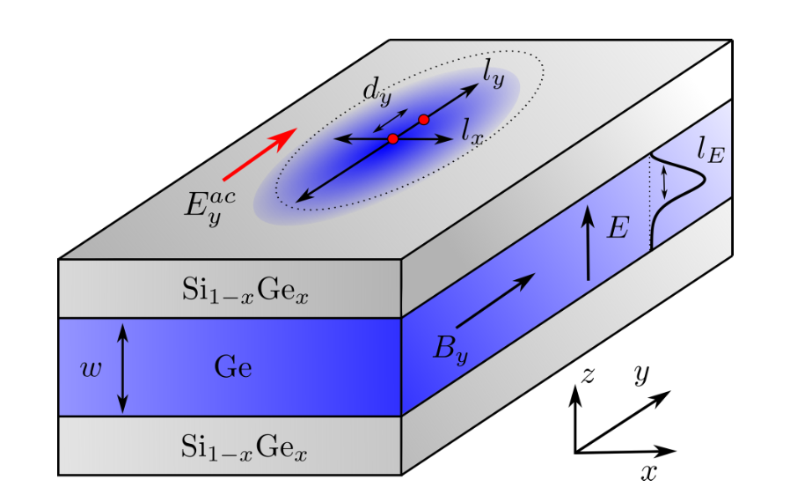
Simulation approach
Example not-corresponding to the left device
Stefano Bosco, Mónica Benito, Christoph Adelsberger, and Daniel Loss Phys. Rev. B 104, 115425

Slide 7
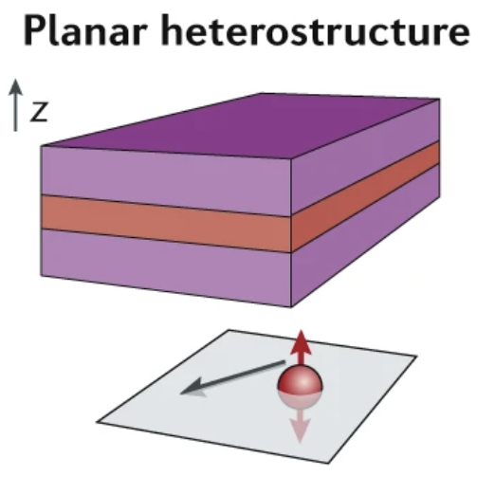
Ge/SiGe planar hole spin qubit simulation
Gate electrode
electrostatic confinement
4-/6-band k.p Hamiltonian (QTSolver)
Band structure and band alignments (QTSolver)
Strain pattern when cooled to cryogenic temperatures (COMSOL)
Spin g-factor (postprocessing)
Tuning the spin-orbit coupling
Rabi oscillation …
SiGe
Ge
SiGe
Quantum well
Nature 2020, 577, 487-491; Nat Comm. 2018, 9, 3255; Nat Rev Mater 2020, 6(10) 926-943; MRS Bulletin 2021, 46(7) 634-64;

Slide 8
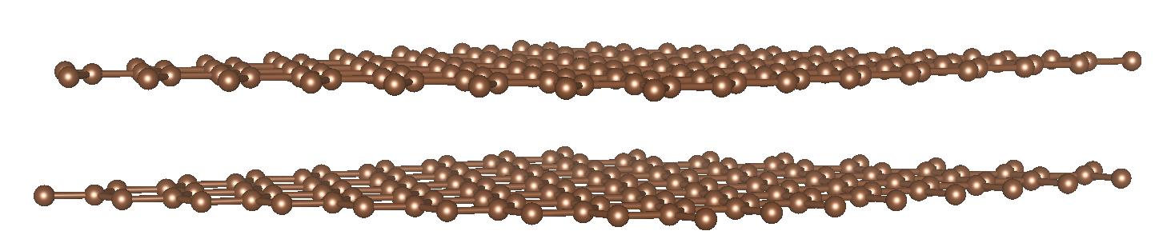
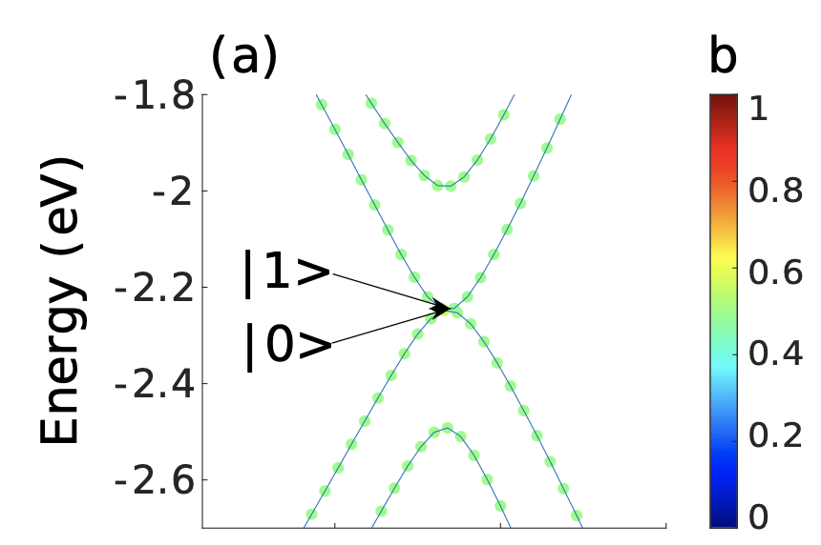
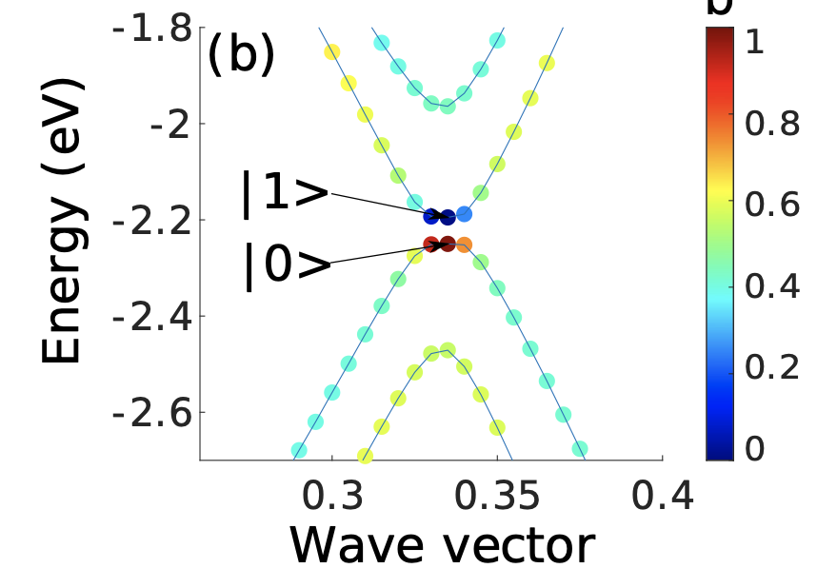
New platform: bilayer graphene (BLG) qubit
Gate control of layer polarization
Quantum dot confinement by electrostatic potential
Easy single-gate operation
Susceptible to charge noise
Two-qubit operation
top
bottom
gate-dependent layer polarization
Phys. Rev. Research 4, 043073 (2022)

Slide 9
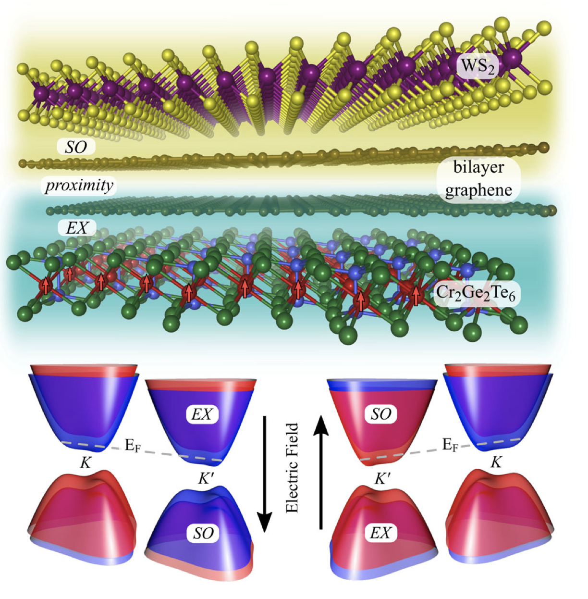
WS₂ / BLG: tunability of SOC and exchange coupling
Top layer of BLG is proximitized by the CGT → exchange coupling (EX)
Bottom layer of BLG is proximitized by the WS₂ → giant spin-orbit coupling (SOC)
Spin qubit with tunable SOC and EX
Largely tunable spin g-factor (?)
Two-qubit gate by exchange interaction
Phys. Rev. Lett. 125, 196402 (2020)

Slide 10
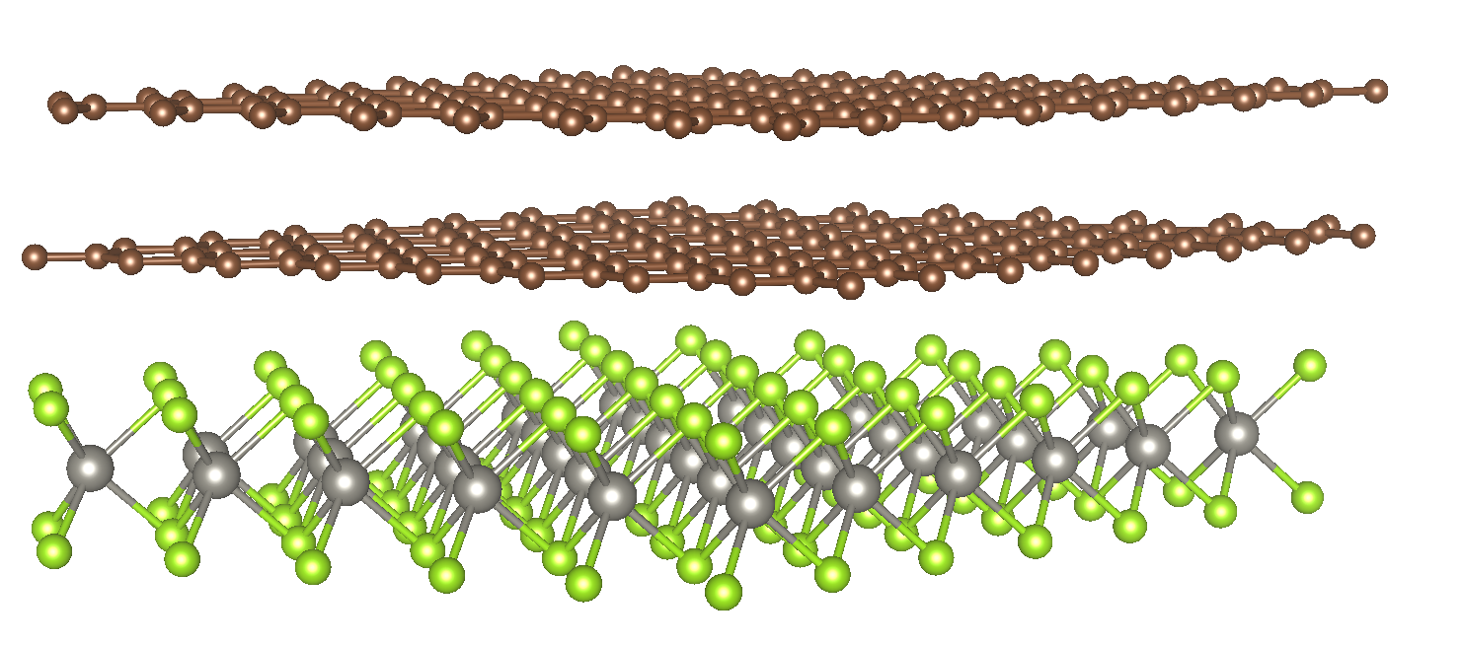
WS₂ / BLG spin qubit simulation
VASP / cp2k : DFT calculation
Construct a 8-band k.p model with SOC
→ Suppl. Mat. PRL 125, 196402 (2020)
Confine quantum dot (QD) in BLG
Show discretized QD energy levels and WF
Calculate spin g-factor
Show gate-tunable spin g-factor
bilayer graphene (BLG)
SO proximity
WS₂

